Slide 1

Exploratory Data Analysis
G2M insight for Cab Investment firm
Submitted by: Negar
October 21, 2022

Slide 2
Agenda
Executive Summary
Problem Statement
Approach
EDA
EDA Summary
Recommendations

Slide 3
Executive Summary
Provide useful information to assist the investor choose the best cab company to invest in.
Cab companies:
Yellow Cab
Pink Cab

Slide 4
Problem Statement
Due to remarkable growth in the Cab Industry in last few years and multiple key players in the market, XYZ is planning for an investment in Cab industry and as per their Go-to-Market(G2M) strategy they want to understand the market before taking final decision.
There are data available for two Cab companies to investigate. Thus, they need to know which Cab company can perform better to invest on.

Slide 5
Approach
Look through each dataset and comprehend it
Identify relationships across the datasets and create a master dataset
Feature transformations
Identify and remove duplicates
Identify NA values and remove them
Outlier detection
Exploratory Data Analysis

Slide 6
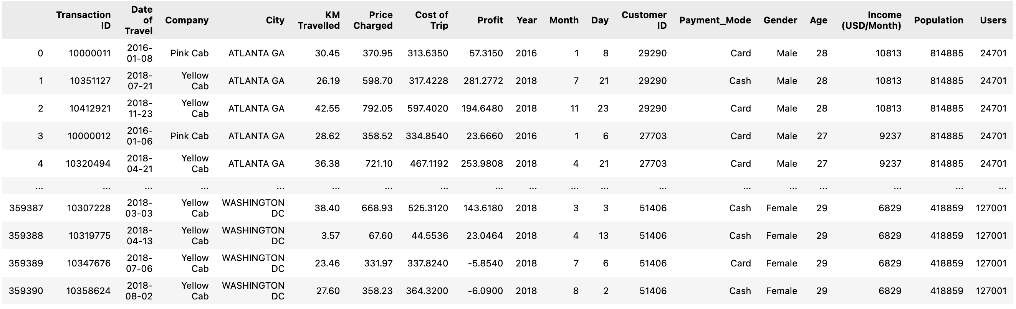
Master Dataset:
Time period of data is from 31/01/2016 to 31/12/2018

Slide 7
Exploratory Data Analysis

Slide 8
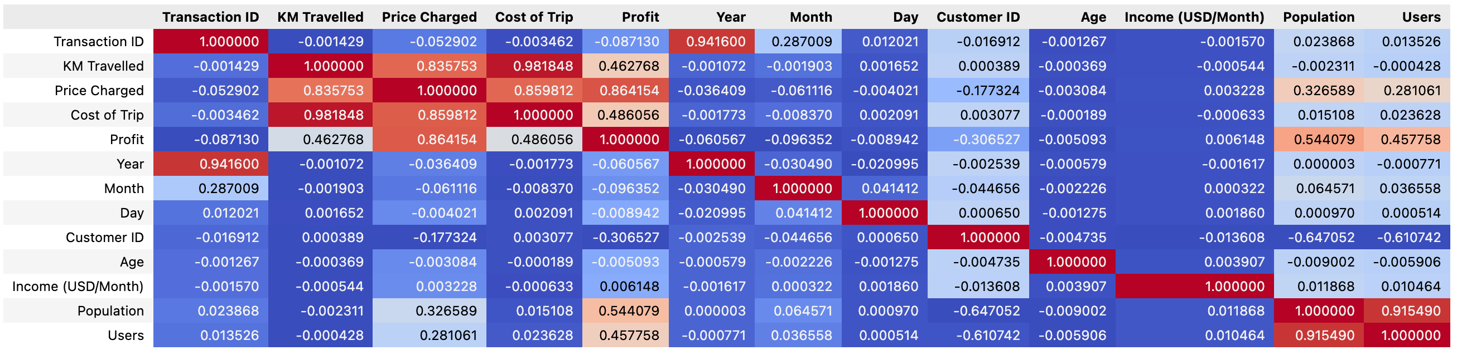
Correlation:
The heatmaps show a strong relationship between 'KM Travelled,' 'Price Charged,' 'Cost of Trip' and 'Profit.' Additionally, and this is rather evident, there is a significant correlation between the 'Population' and 'Users.'

Slide 9
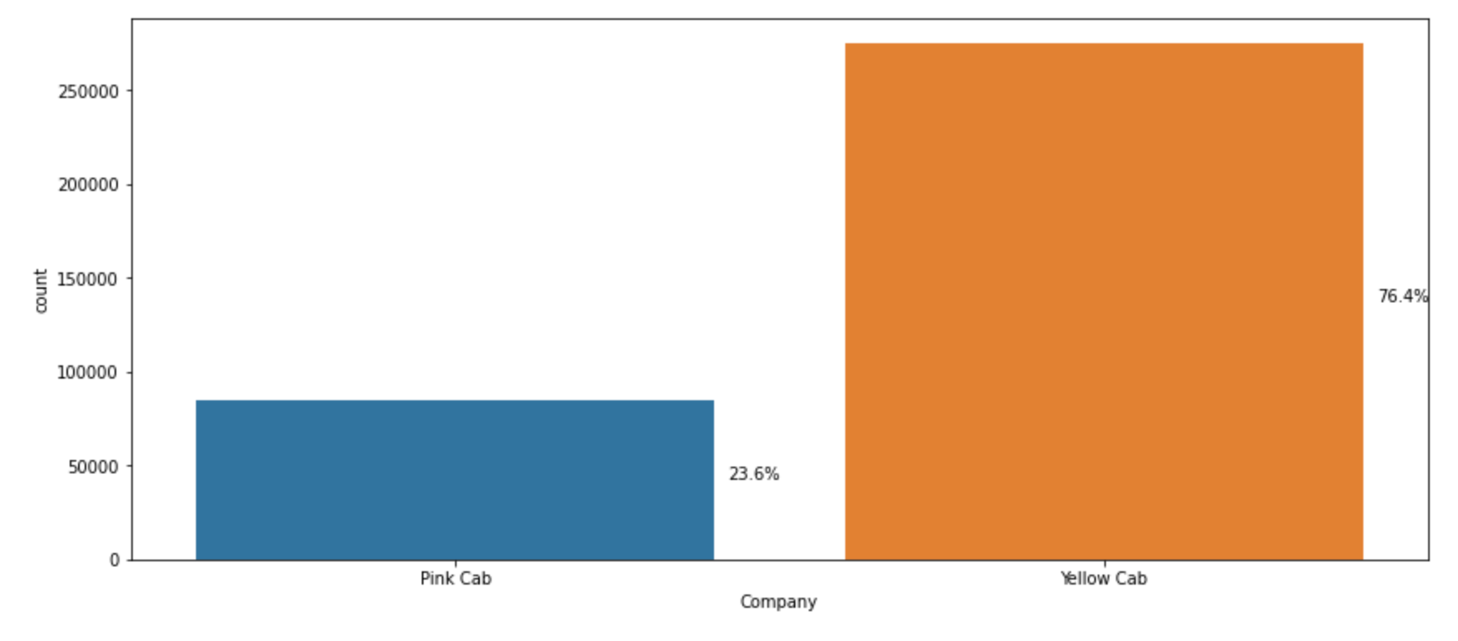
Distribution of Cabs
About 75% of cabs come from the yellow cab company, and 25% from the pink cab company. Thus, It seems that consumers like the "Yellow Cab" over the "Pink Cab" more.

Slide 10
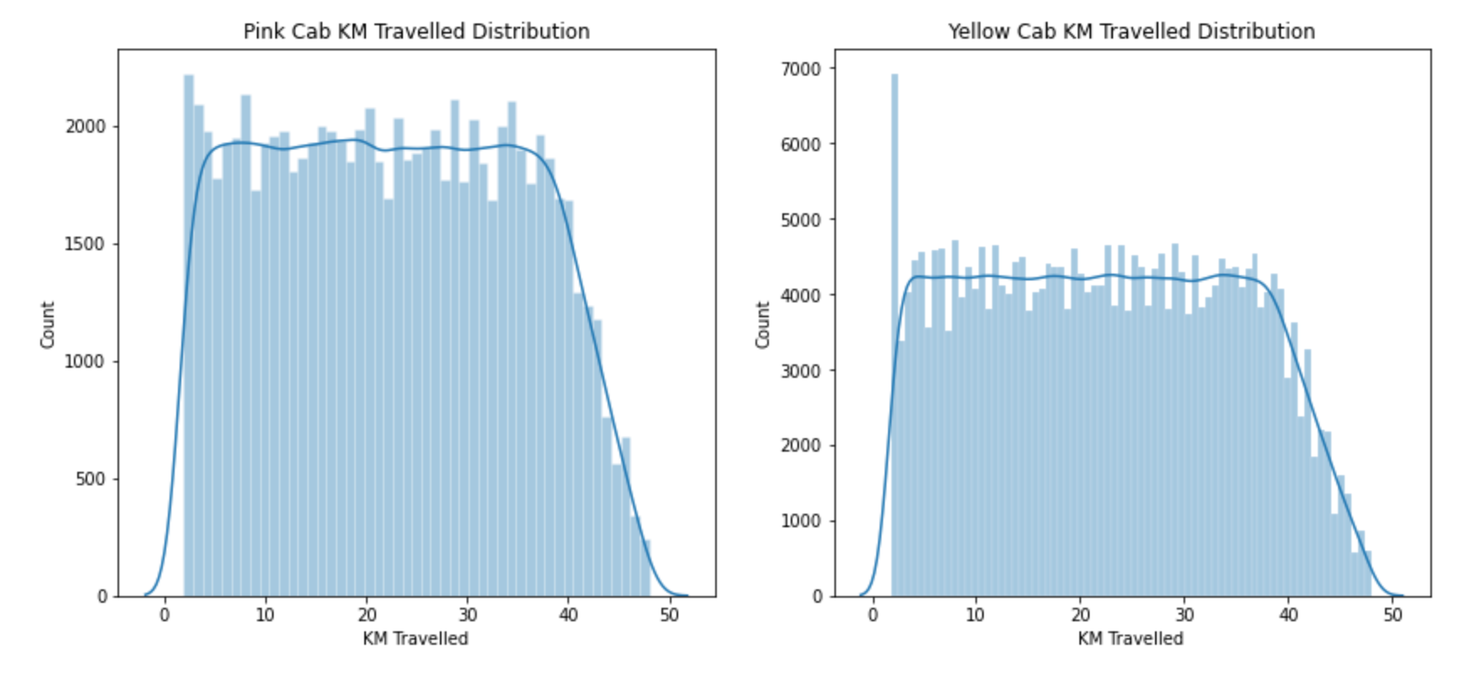
KM Travelled Distribution
Most rides range in length from 2 to 48 kilometers for both Pink and Yellow cabs.

Slide 11
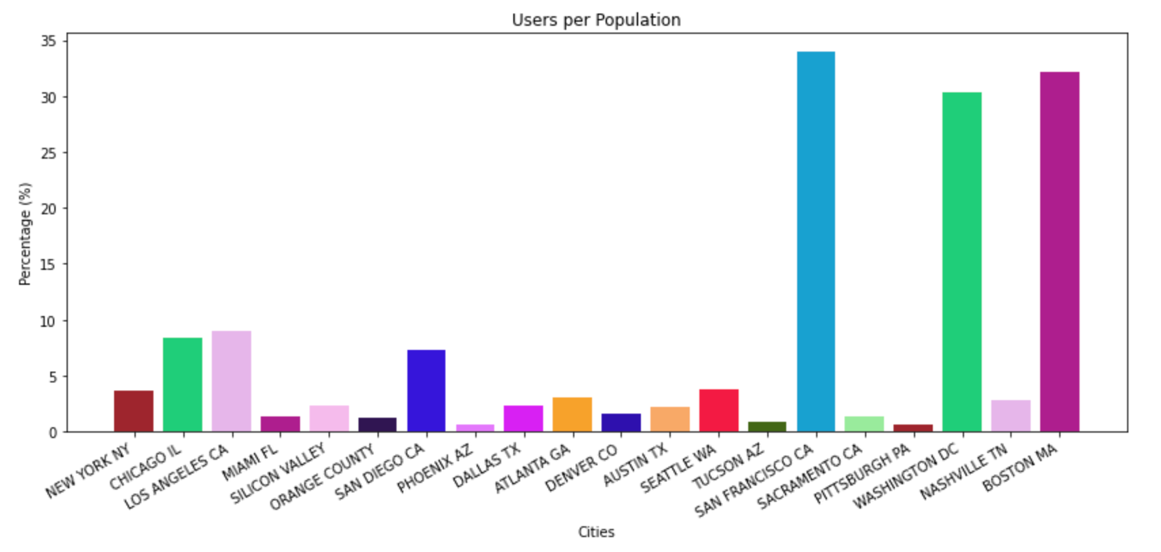
Users per population
More than 30% of people in the cities of "San Francisco," "Washington," and "Boston" use taxis.

Slide 12
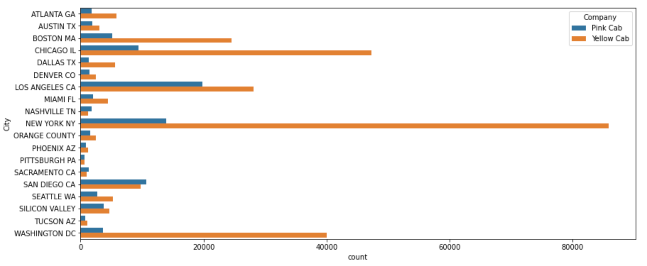
Pink and Yellow cab Users Distribution
People in the cities of "Boston," "Chicago," "Los Angeles," "New York" and "Washington," far prefer Yellow Cab rather than Pink.

Slide 13
Which company has maximum cab users at a particular time period?
In all months, Yellow Cab sees a higher volume of passengers. In December, it had the most trips (35439), compared to Pink Cab’s (11568).

Slide 14
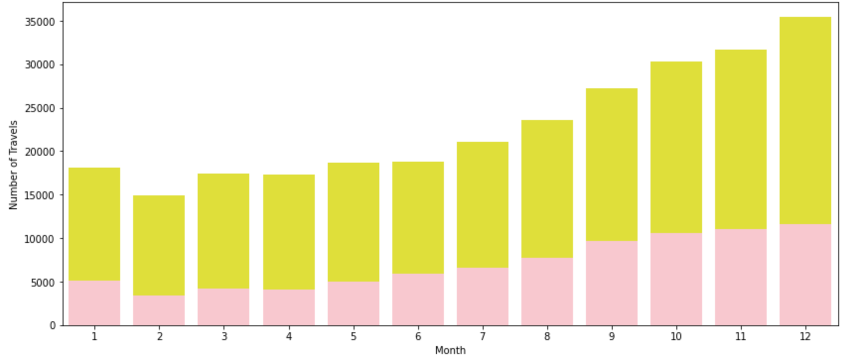
Monthly Travel Distribution

Slide 15
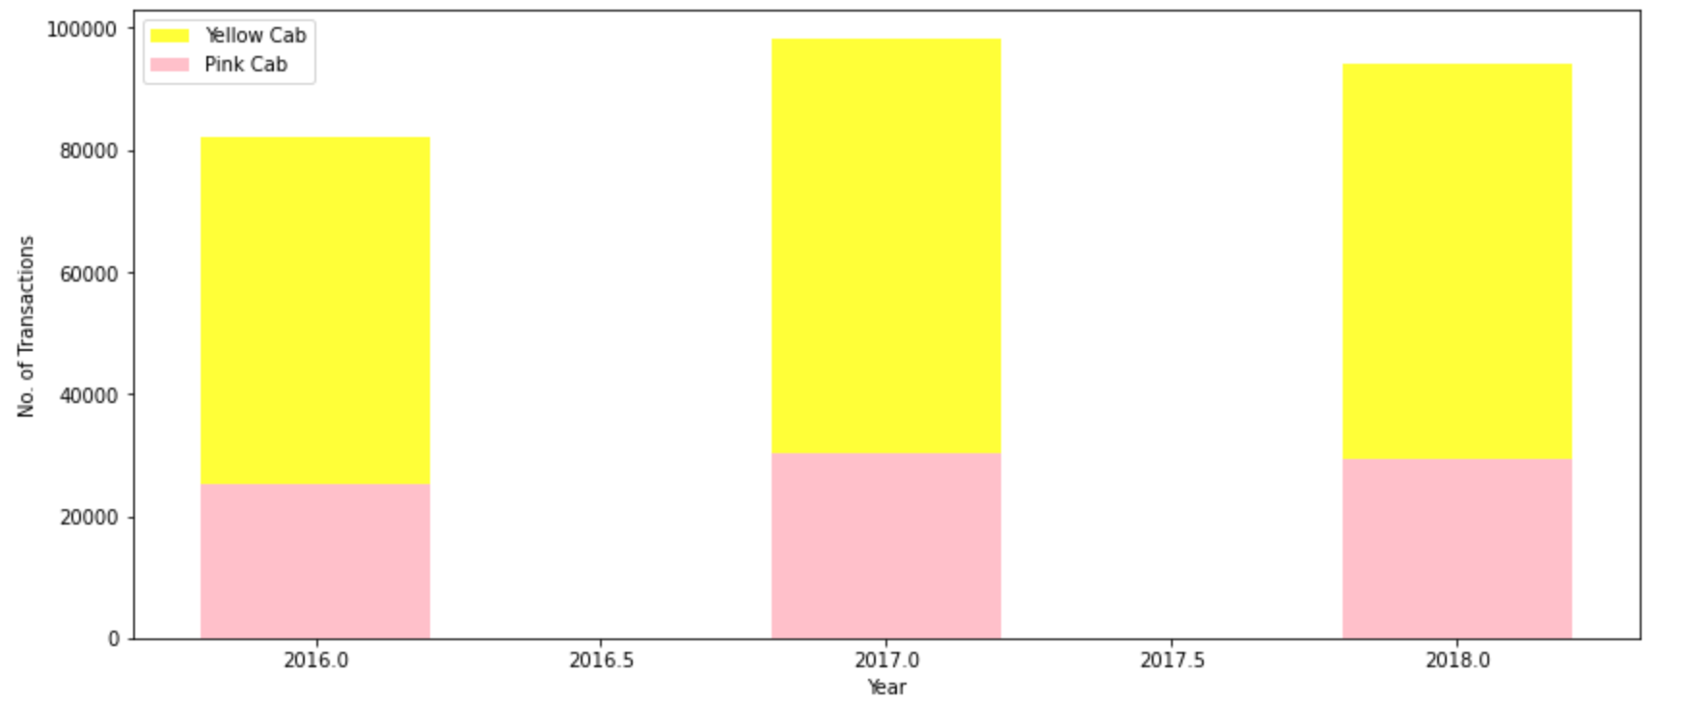
Yearly Travel Distribution

Slide 16
Does margin proportionally increase with increase by travelled distance?
According the following plots, not necessarily the margin will increase based on travelled distance. In some KMs the profit is negative that might be because of the discounts.

Slide 17
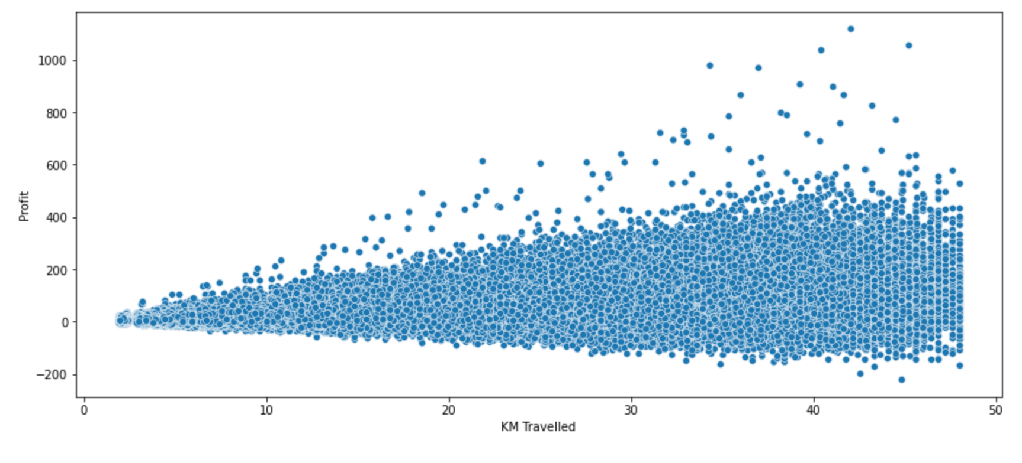
Margin based on KM Travelled for Pink Cab

Slide 18
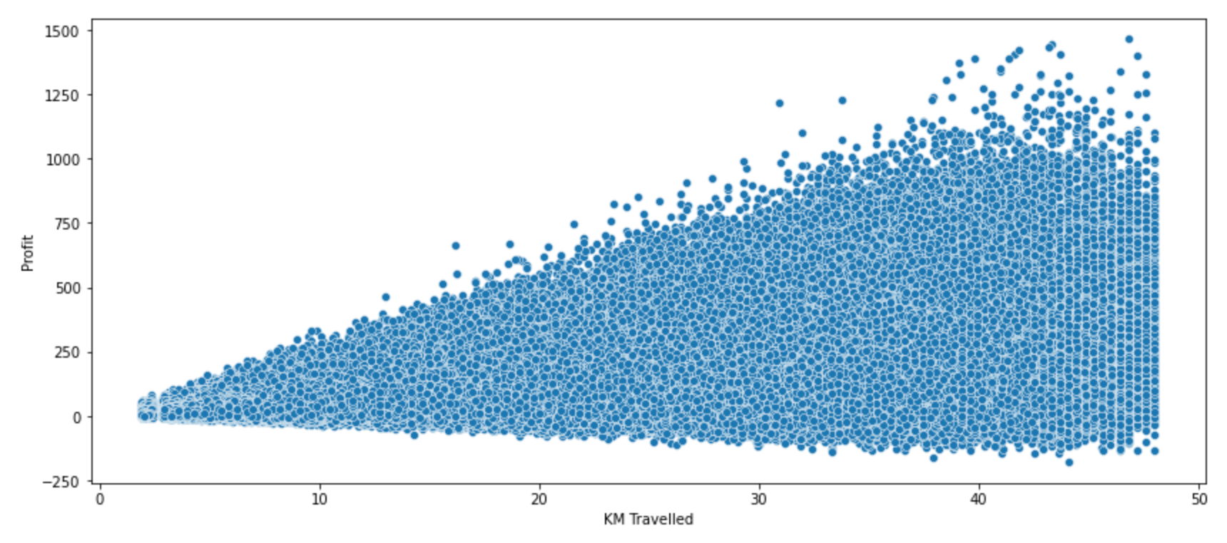
Margin based on KM Travelled for Yellow Cab

Slide 19
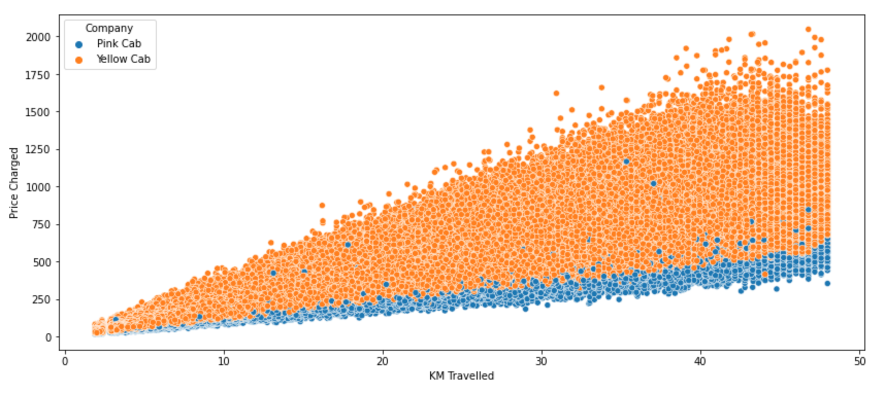
Price Charged based on KM Travelled
the relationship between KM travelled and the price charged is linear.
However, Yellow Cab's rates are higher than Pink Cab's.

Slide 20
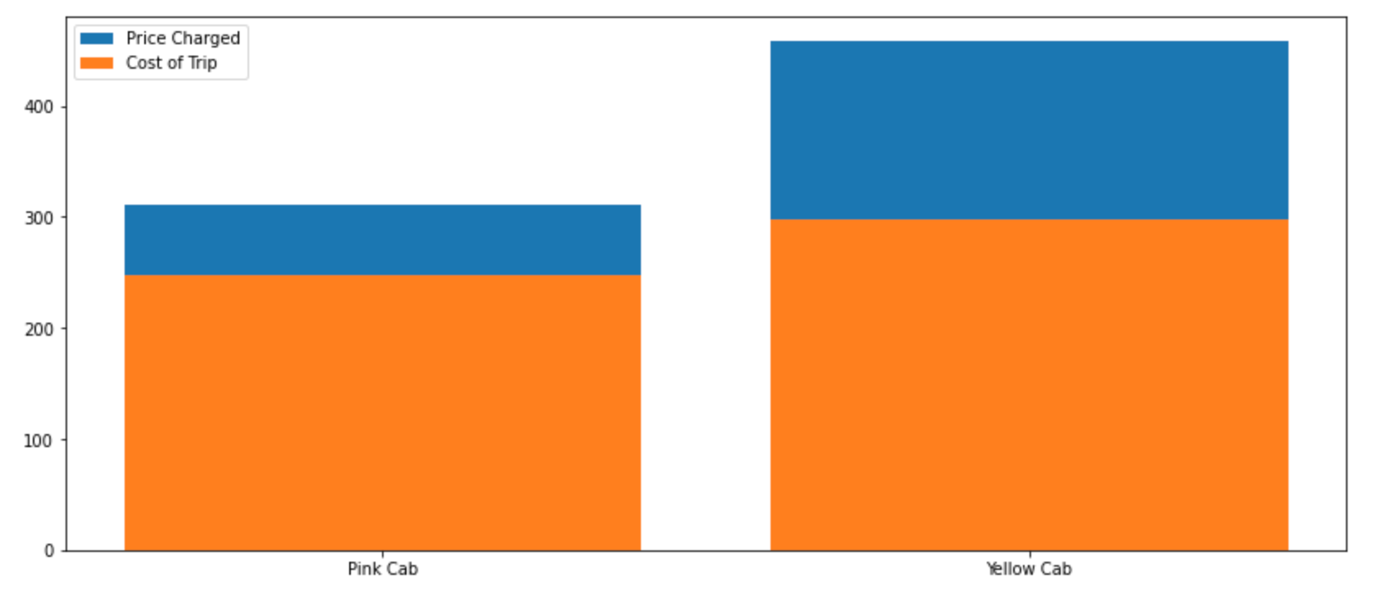
Price Charged based on KM Travelled
In comparison to the Pink cab, the Yellow cab has a bigger profit margin.

Slide 21
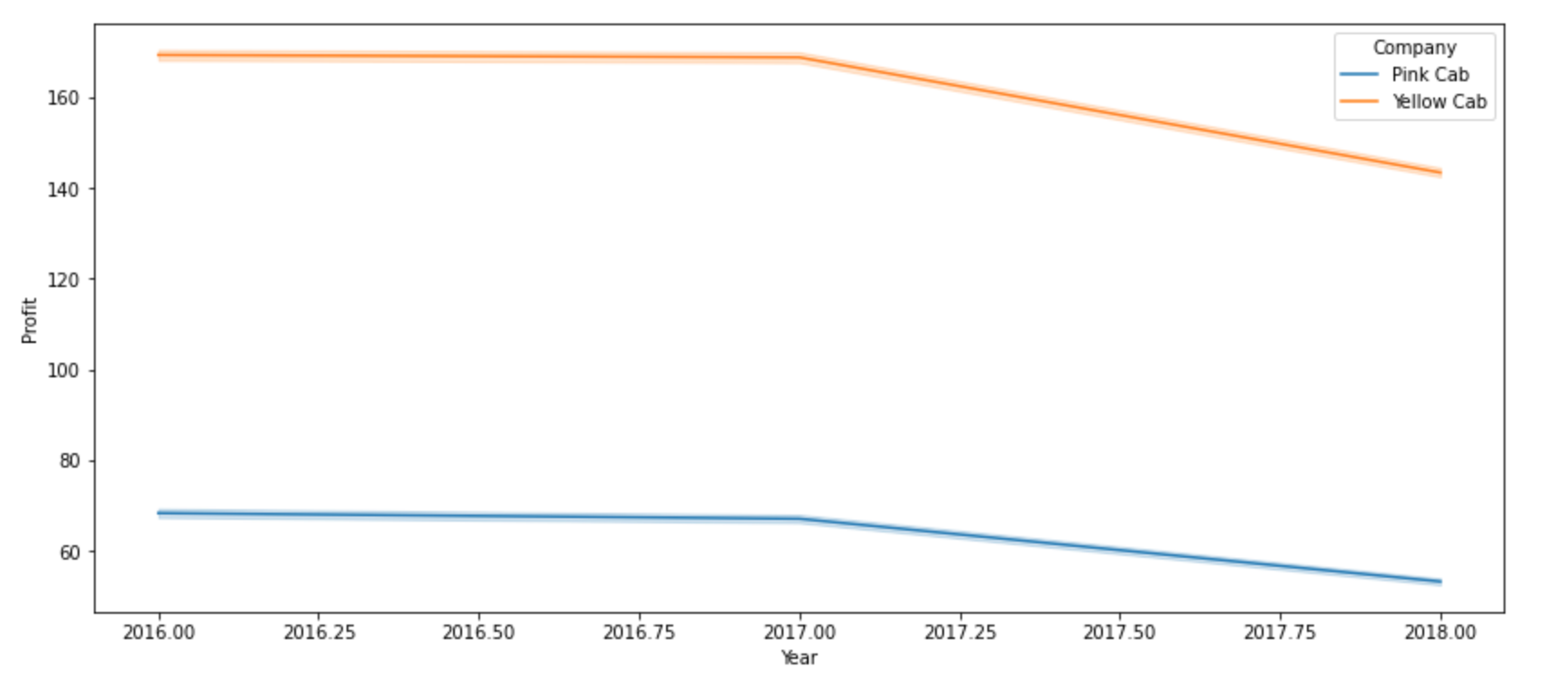
Profit Margin per Year
The profit margin decreased over years.

Slide 22
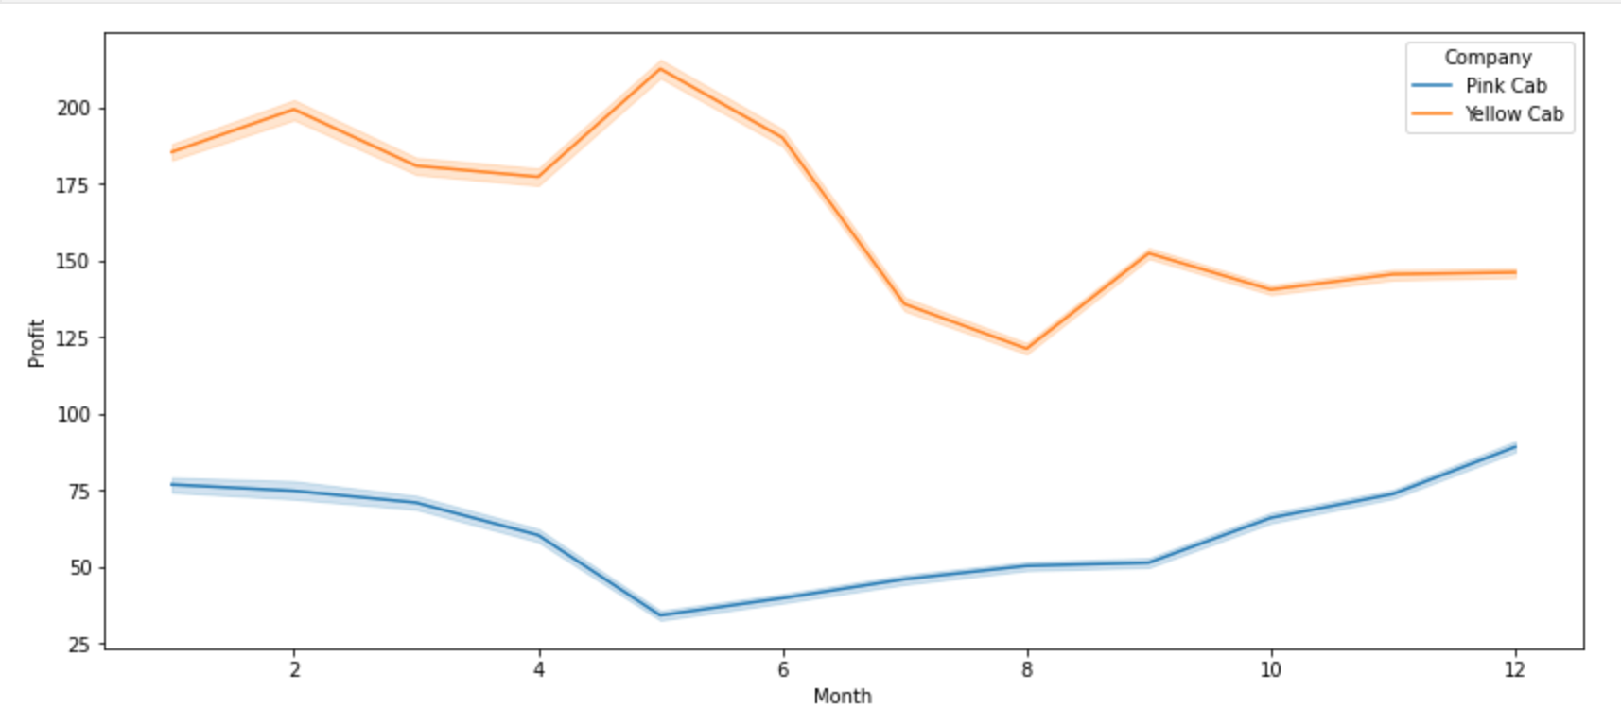
Profit Margin per Year
Month to month, the profit margin changes.

Slide 23
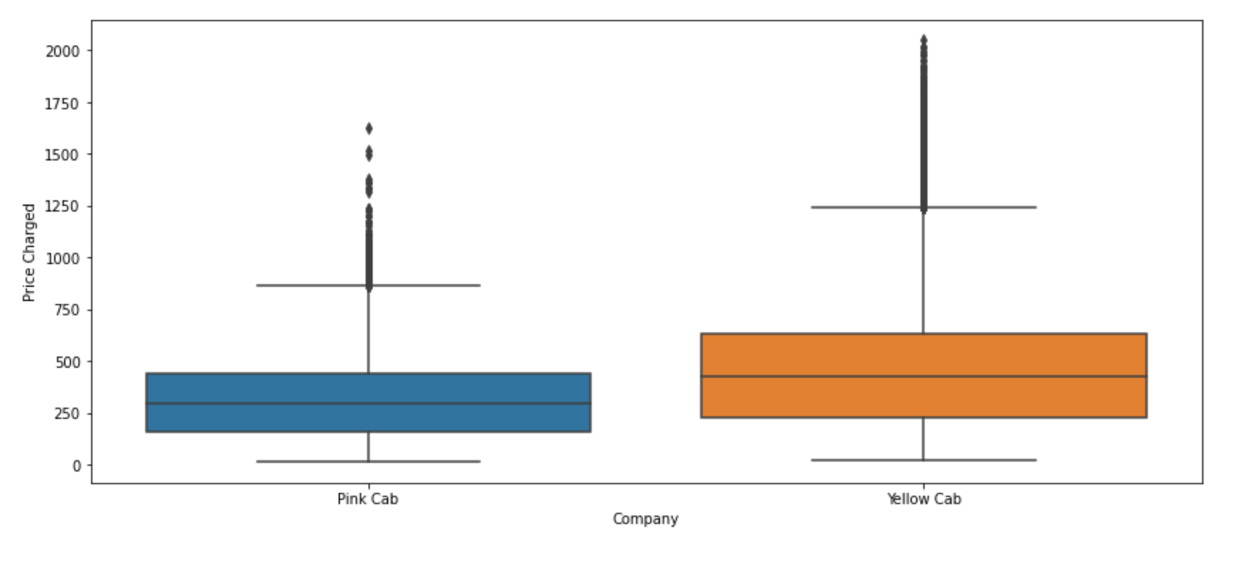
Price Charged
"Yellow Cab" Price Charged is higher than " Pink Cab” and the average is almost double.

Slide 24
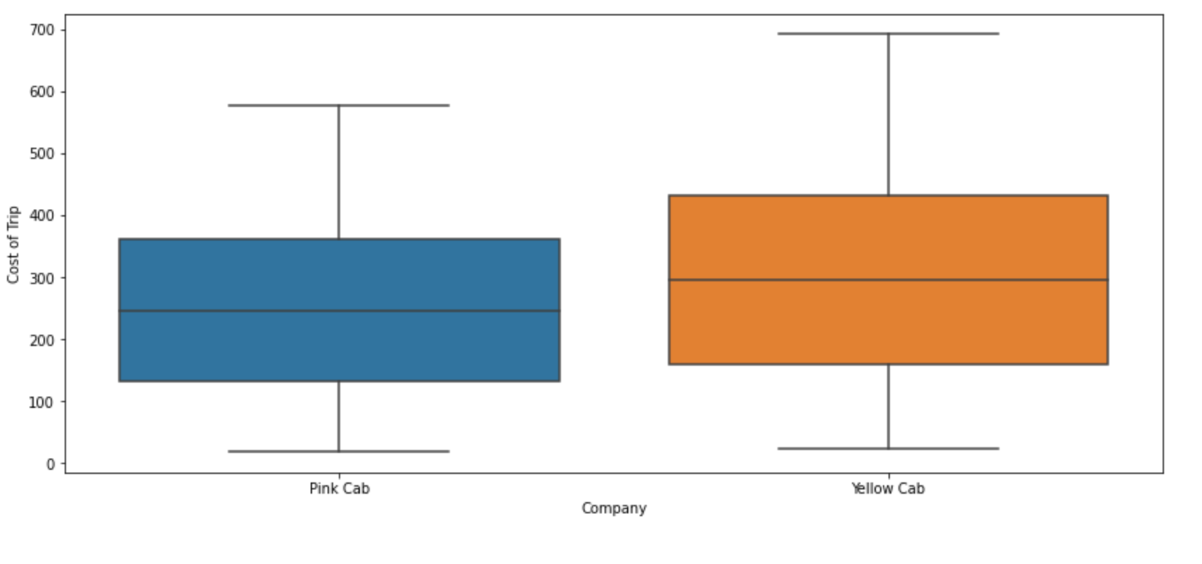
Trip Cost
Overall "Yellow Cab" trip cost is higher than " Pink Cab”.

Slide 25
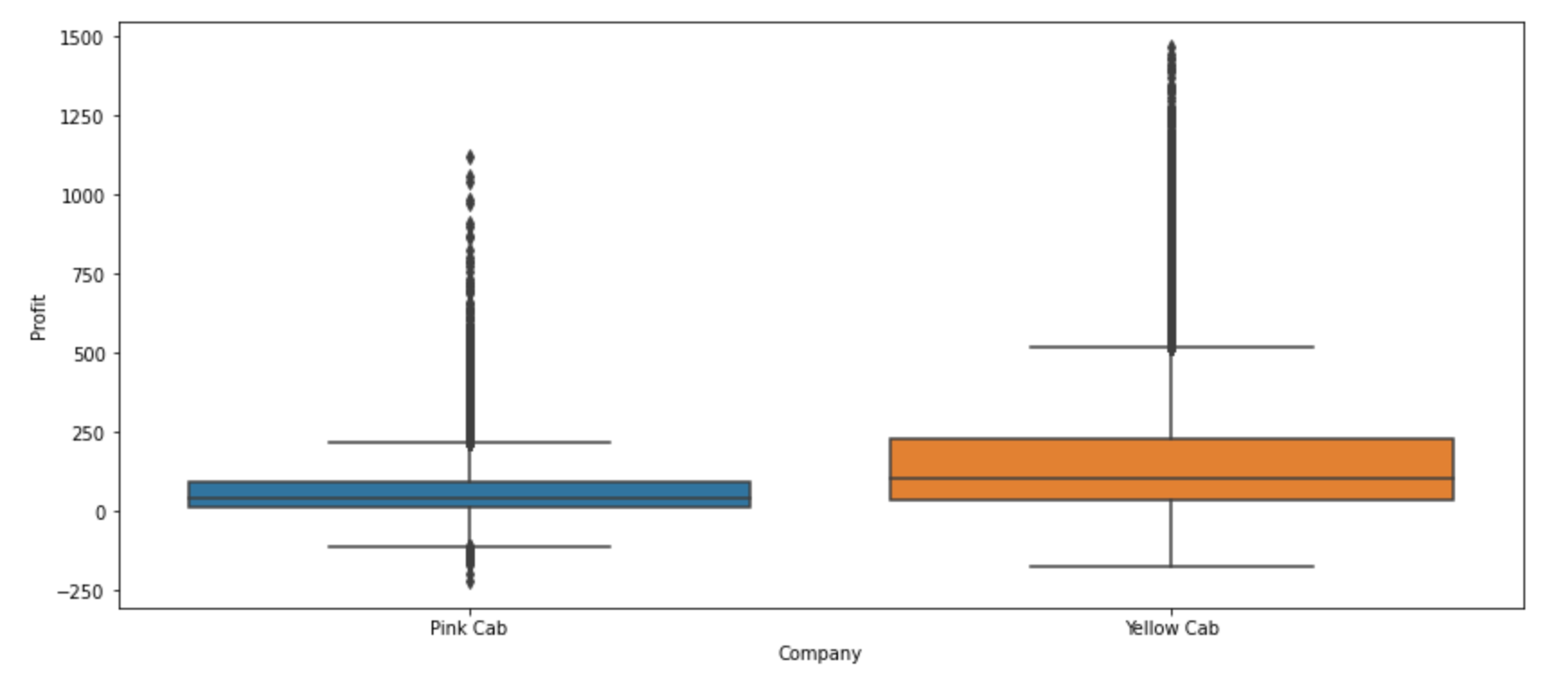
Average Profit
As a result, the Yellow cab average profit is higher than the Pink cab.

Slide 26
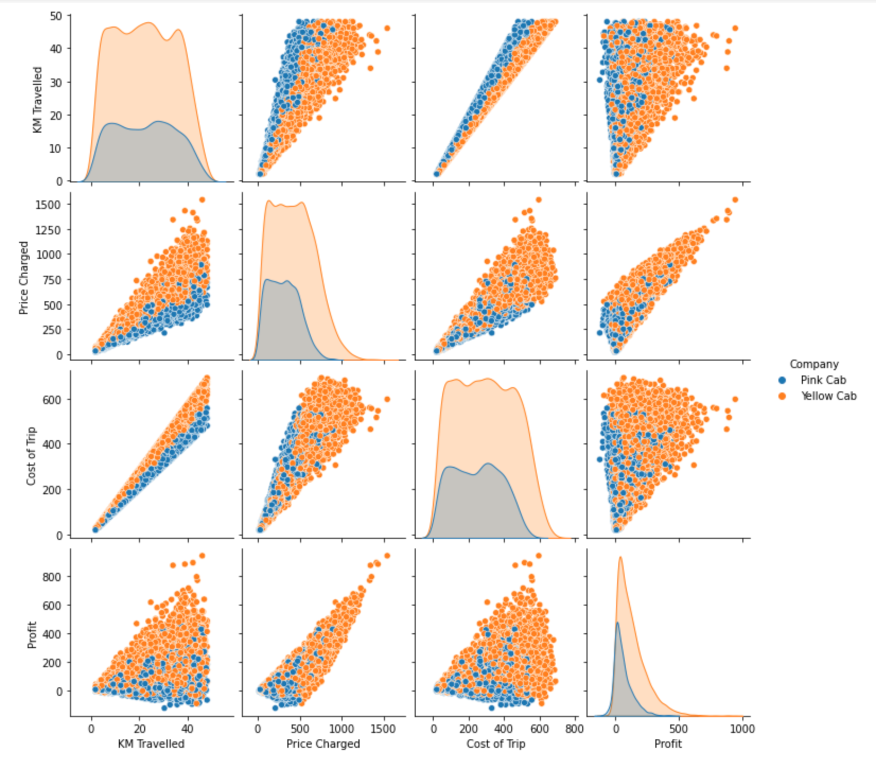
EDA Summary
Compared to Pink Cab, Yellow Cab is thought to be more profitable.
The users like yellow cabs over pink cabs.
The most travel occurs in December, which makes sense given that it's often a month of holidays.

Slide 27
Recommendations
Yellow Cab Company would be a better investment than Pink Cab Company since it has a higher profit margin, more users, and more transactions annually.

Slide 28
Thank You

